Slide 1
THE BOOKS I AM READING
MUJEEB UR RAHMAN
21PWCSE2021
SECTION:B

Slide 2
Following are the book
The president contract.
A night.
Mr. Werewolf.
Please spare me.
Diary of stickman.
Goosebumps horror land: part 2.
Goosebumps horror land: part 3.
404 case manual: 30 seconds till apocalypse.
Strange detective.

Slide 3
I am going to discuss.
404 case manual: 30 seconds till apocalypse.
Strange detective.

Slide 4
STRANGE DETECTIVE
A police officer who resigned.
Solving supernatural cases.
First case about shadow bacteria.
A case about black hole related Einstein-Rison bridge about travelling through different dimension.
This bacteria transform into monster killing people by throttling the neck.
749th bureau officially solving these case .
Summary.

Slide 5
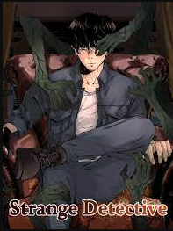
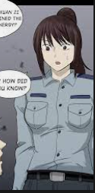

COVER PAGE
(wang you)
749th bureau detective group head
Wang you’s teammate officer(Xuan zi )

Slide 6
404 case manual: 30 seconds till apocalypse.
Apocalypse is a sudden supernatural change or disaster.
Science related (time dimension, time loops).
It all started when a kid trying to suicide from top of a train station.
Apocalypse 1 :Train station disaster.
Apocalypse 2 :Animals attack.
Apocalypse 3 :Solar emotional effect.
Apocalypse 4 :Gigantic insects attack.
Apocalypse 5 :Underground ancient attack.(current).
Characters and summary.

Slide 7
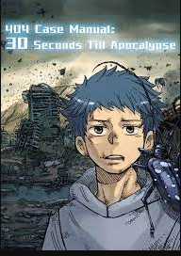
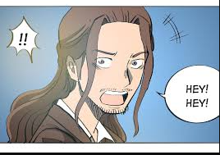
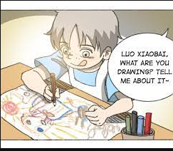
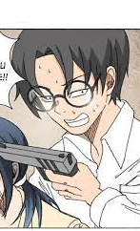
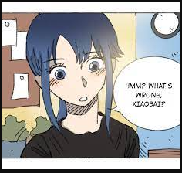
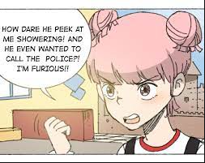
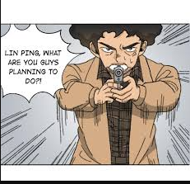
Cover page
(Xiwang)
PROFESSOR YOU
XIAOBAI
QIQI
LING PING
MASTER NI
CAPTAIN WANG

Slide 8
Thank you

